Slide 1
Flexitive
Summary

Slide 2
Schneider H5 Banner
Good: Different size and ratio’s image can be changed rapidly.
Bad: When changing the image also changed the other templates image. I suppose they use the same image.

Slide 3
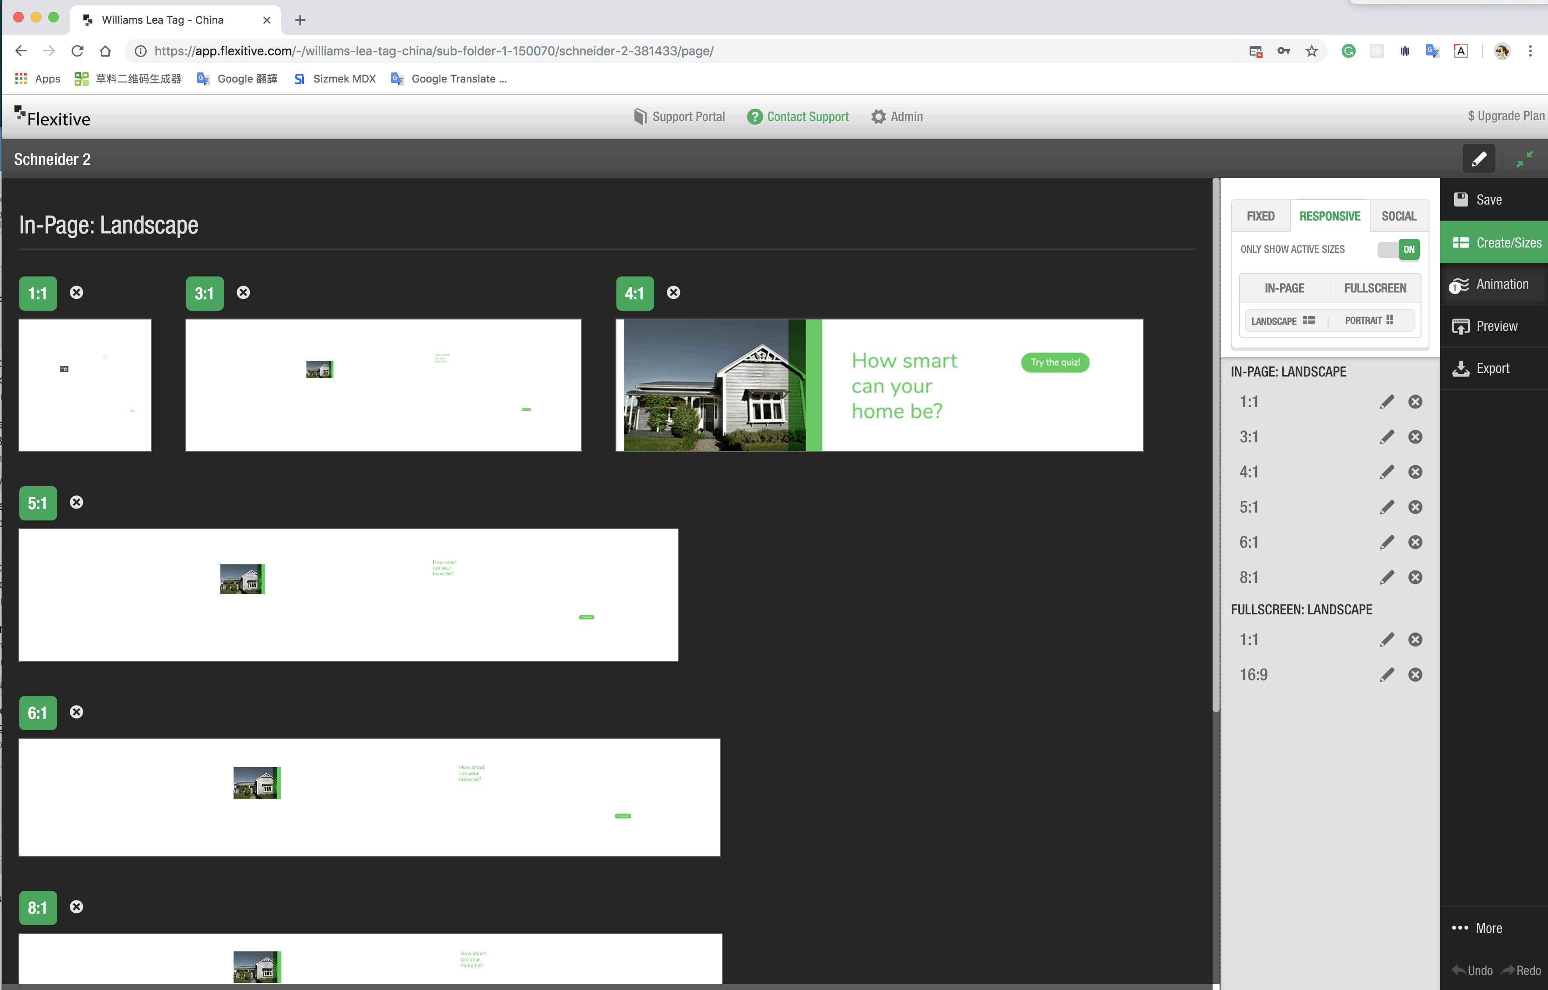

Slide 4
Good: Upload the font is convenience.
Bad: Edit banners’ position precision still need to improve. It hasn’t the ‘Rulers’ and ‘Extras’ like Adobe.

Slide 5
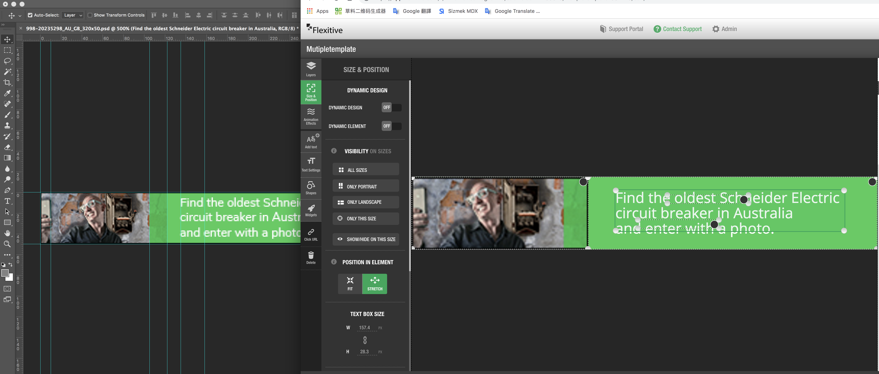

Slide 6
Good: Preview page can review multiple banners a meanwhile.

Slide 7
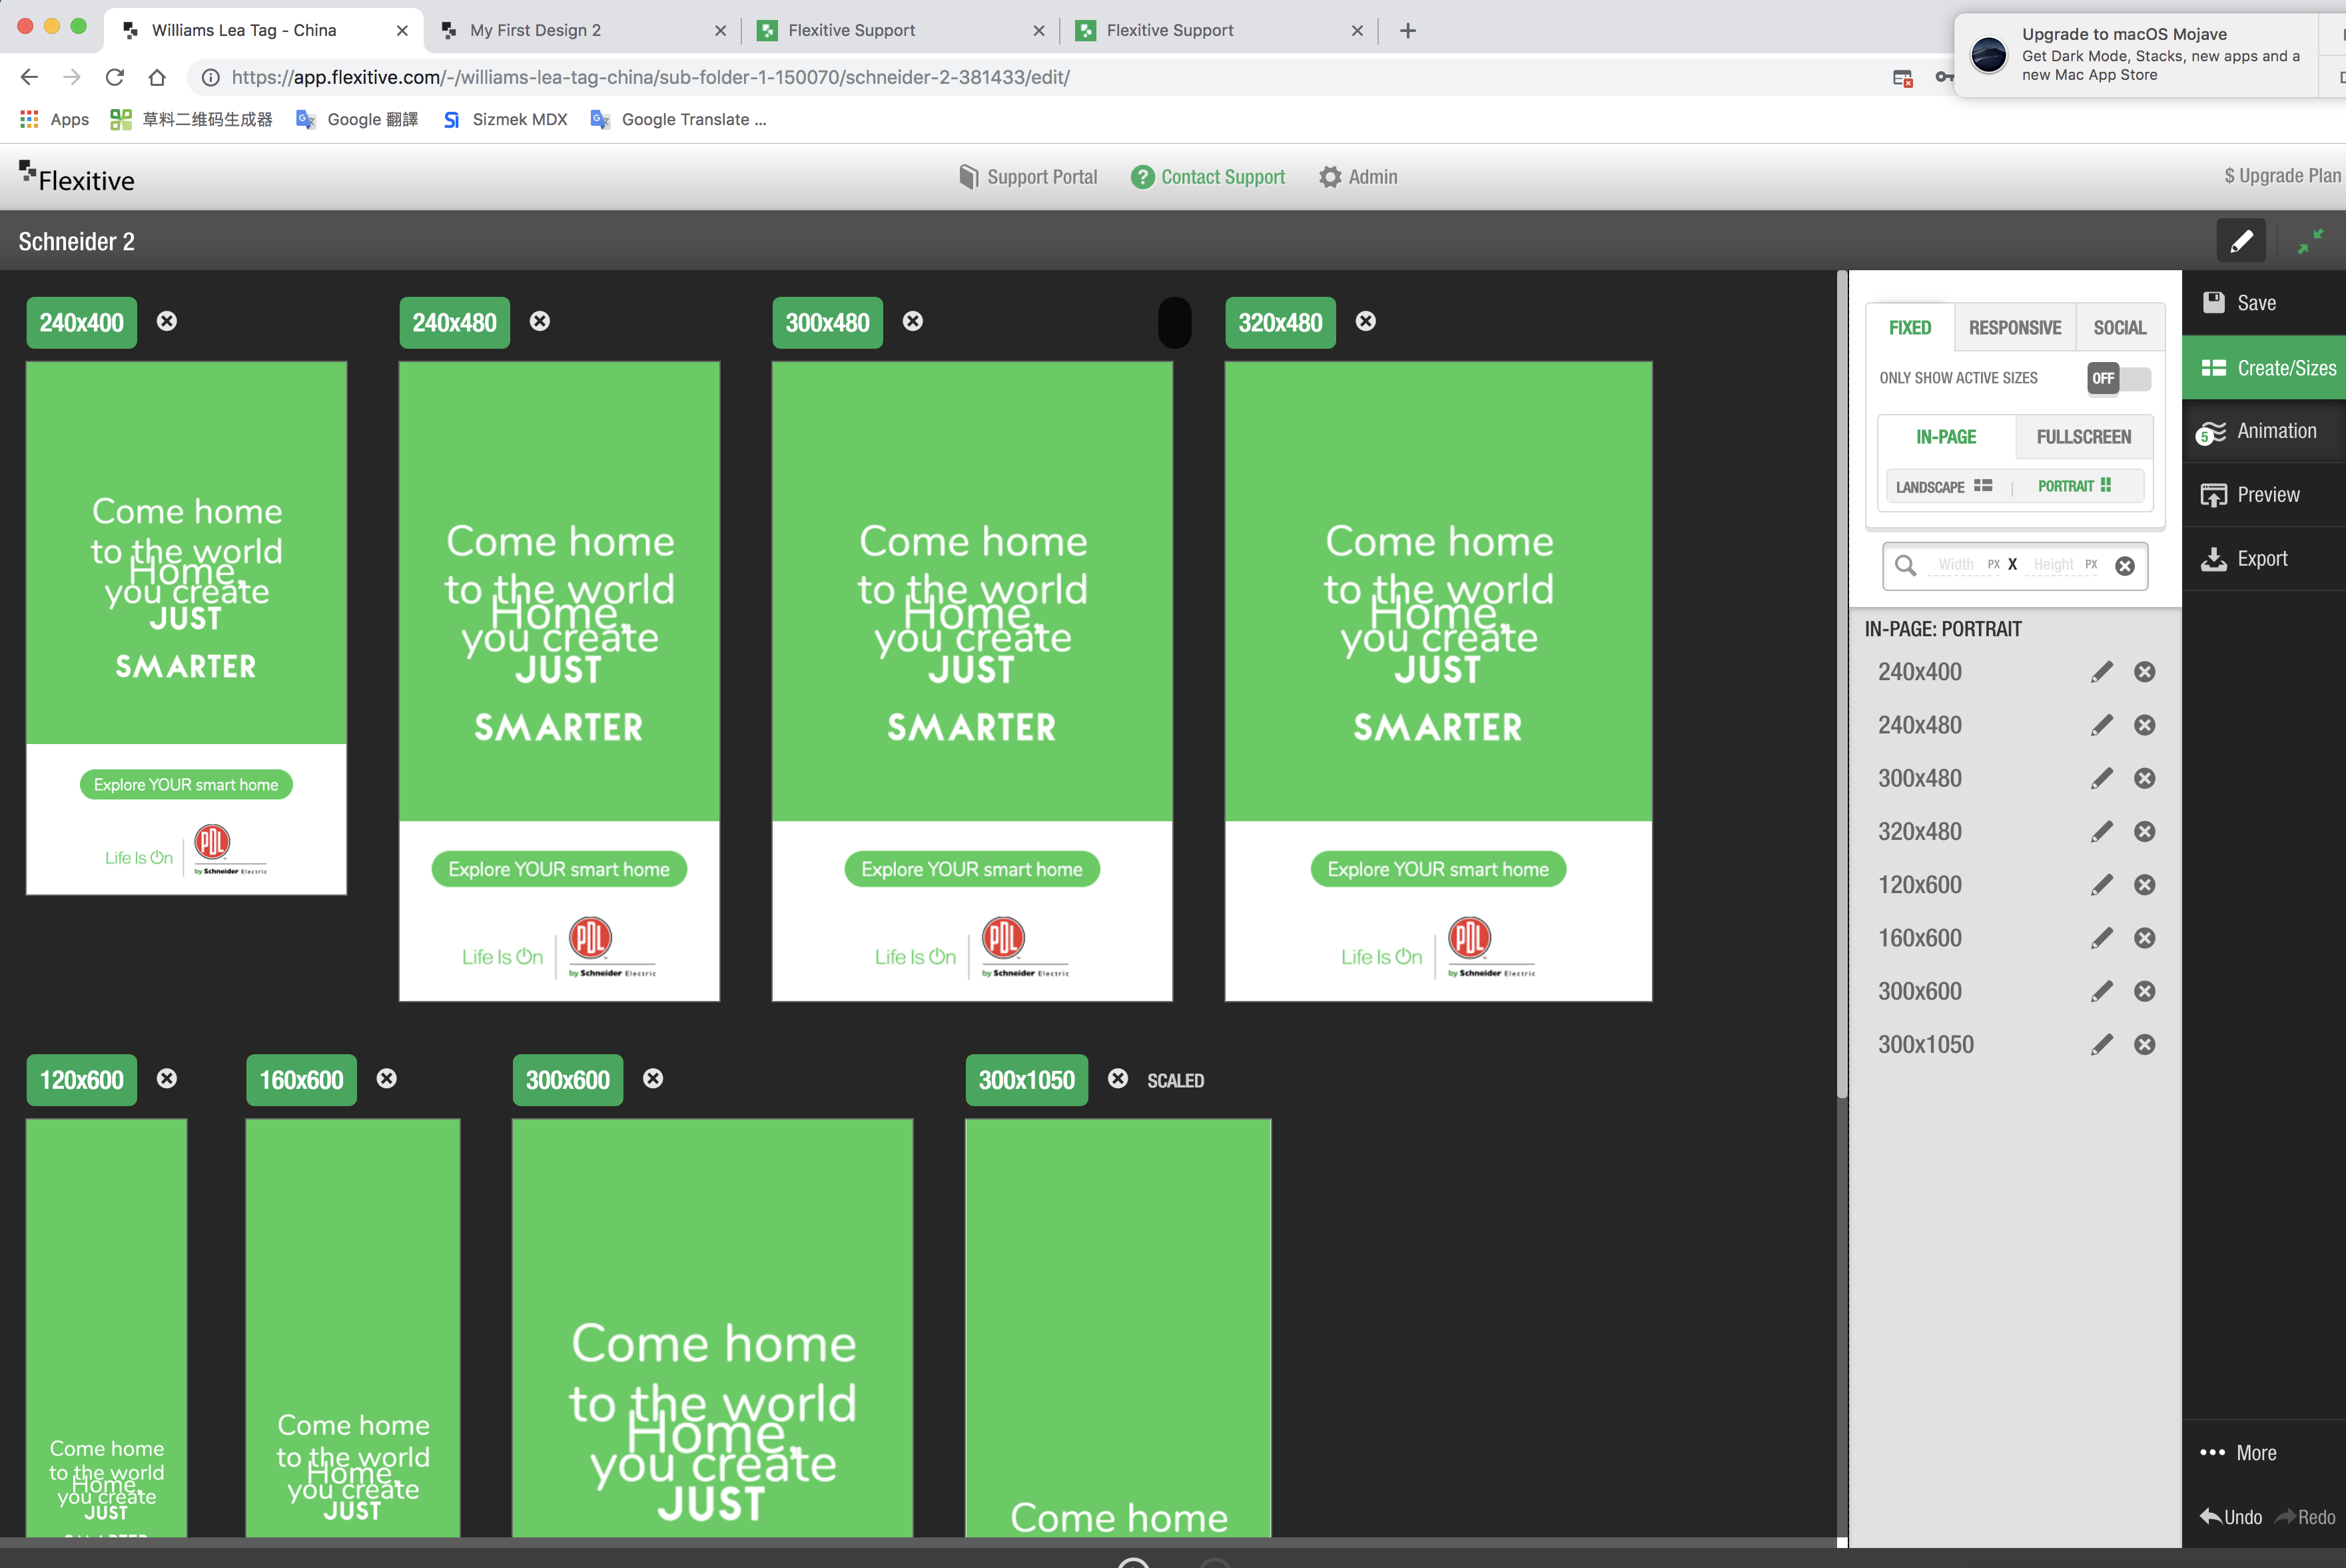

Slide 8
Good: A lot of banners can be download and share at the same time.
Good: Support multiple platforms, such as Sizmek and DCM.

Slide 9
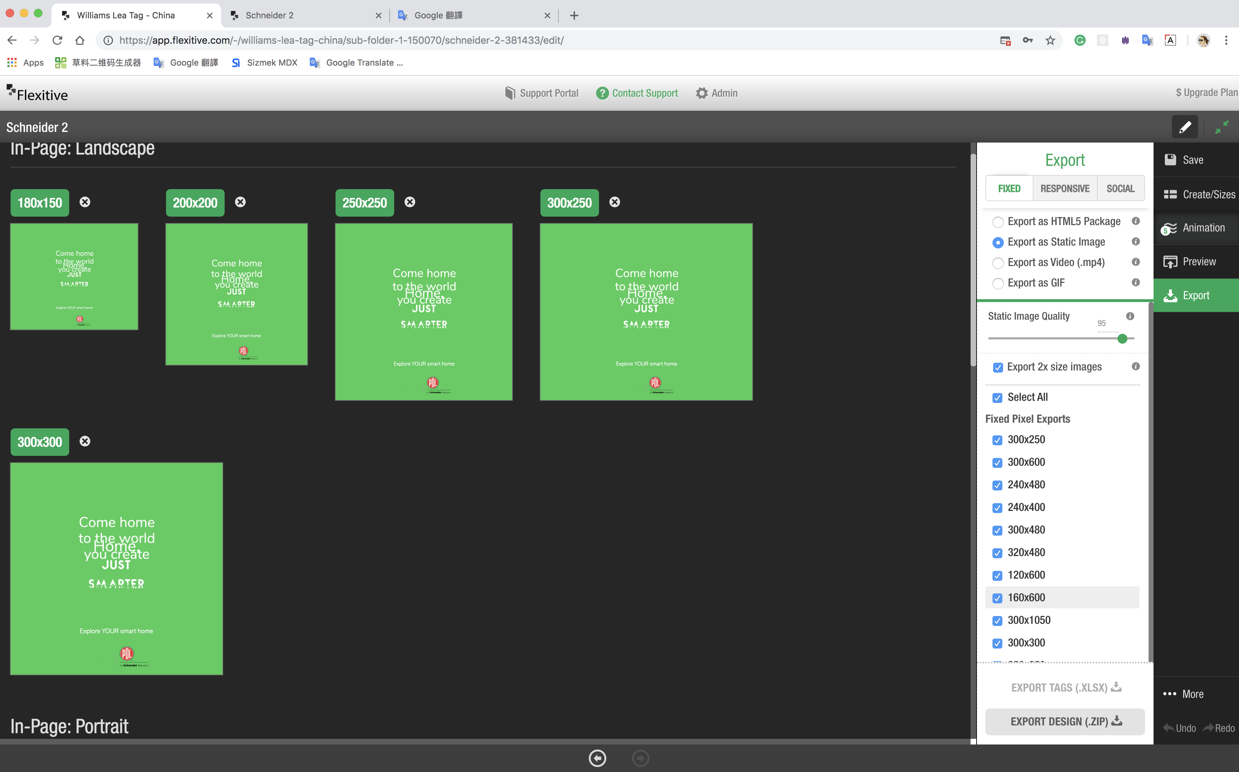

Slide 10
Good: Code and compress are good.
Bad: Some image is too compressed and blurred.

Slide 11
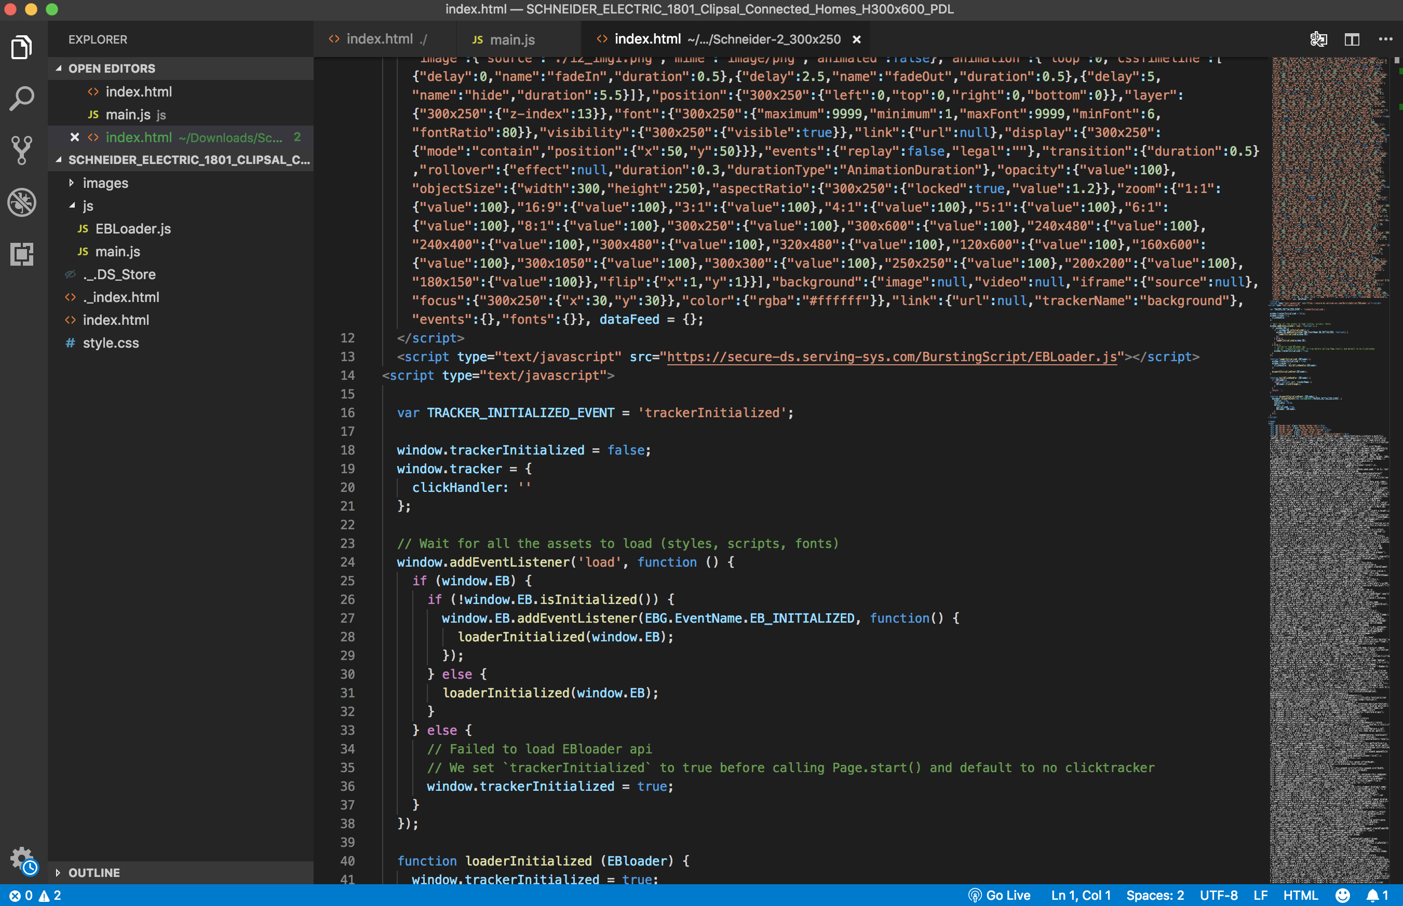

Slide 12
